Slide 1
Defining / Measuring Better:
Engagement
Hooked on videos questionnaire (measures affective involvement, enjoyment, aesthetics, focused attention, and cognitive involvement)
Cognitive Effort
NASA TLX
Understandability (can you understand the message w/ any VL)
Can you id the message
Small VLAT
Set up
Option 1:
Videos as part of instagram / tic tok
Option 2:
News reporting
Option 3
Straight comparisons (like data videos did)
General Flow
Consent
Instructions
Task
Questionnaires
Data Vid Engagement
NASA TLX
Mini-VLAT
Demographic

Slide 2



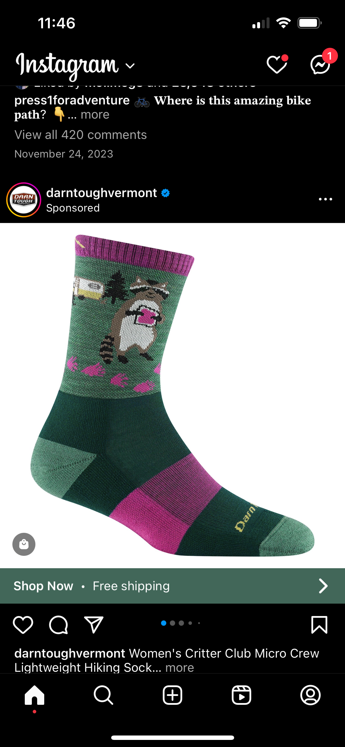

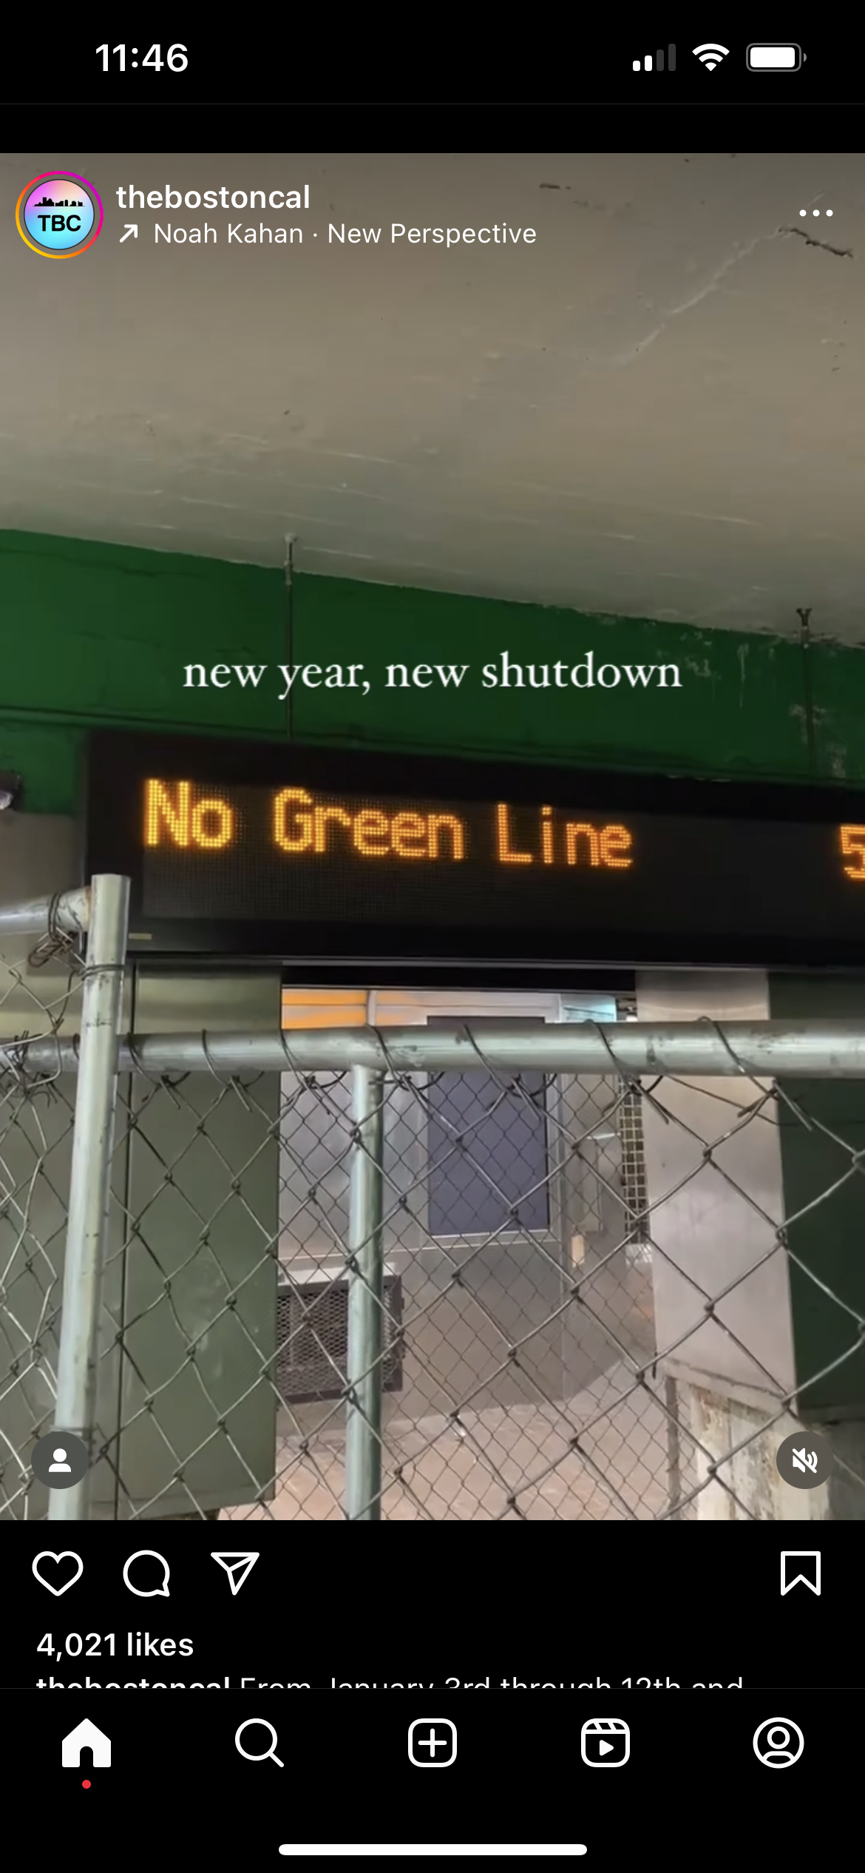
Option 1 – Social Media
Stimuli
Scrolling through a news feed
Have “distractors” and one vis
Vis is either:
Data Video
Animation
Static (could have pages?)
Task
Always same set of distractors
Some should be static and some also videos
Randomize order things show up in

Slide 3
Option 2 – News Reporting

Slide 4
Option 3 – Copy Data Videos

